Slide 1
Alia:UVI Dining
CSC 420: Software Engineering
Rhonda Forbes
Thalia L. Guadalupe
Final Report
Notes:
Good afternoon, My name is Thalia L. Guadalupe and my group member name is Rhonda Forbes.

Slide 2
Introduction
The University of the Virgin Islands currently does not have a website that shows their cafeteria menu. In order to see what’s on the menu, students, staff, and guests have to visit the cafeteria. To solve this problem, Alias built a UVI cafeteria website.
Notes:
The University of the Virgin Islands does not have a cafeteria menu. Every day, students, staff, and the occasional guests have to visit the cafeteria in order to see the menu. Cafeteria workers is burdened by having to use an excel sheet to update the menu. To solve this problem, we at Alias decided to build a cafeteria for the University of the Virgin Islands.

Slide 3

SoW Form
Design Features & Functions
Staff can log in
Staff can add food
Staff can display food
Bonus:
Staff can add a user.
Staff can log out
Notes:
As you can see we have that staff can log in, add food, display, add a user, and in our status report. We also added extra functions like the staff being able to log out, and staff adding other users.

Slide 4
Roles
Using MVC pattern (Web development); our roles are as follow:
Rhonda
Frontend(View)
Database(Tables)
Thalia
Backend(Controller)
Database(Tables & Model)
Notes:
These are the roles and responsibilities Thalia and I took on in order to complete our project. We used Visual Studio 2017 and used the MVC web development pattern. I worked on the Frontend which was the view, and the database tables. Thalia worked on the backend controller, and the database tables with me, and also she worked on the model.

Slide 5
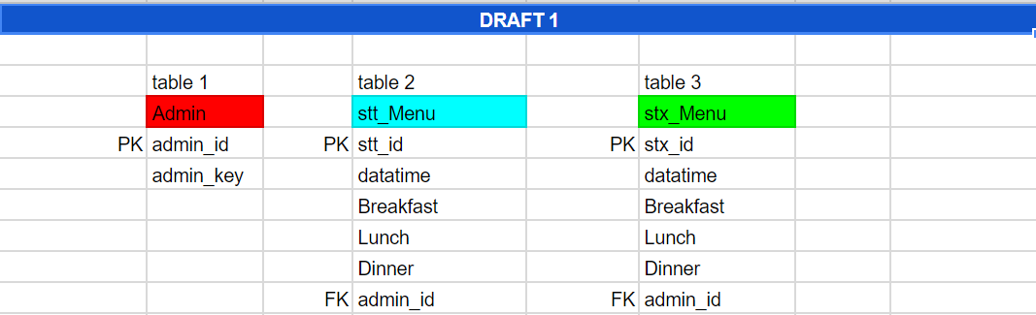
First database tables
Notes:
These are our datatables. Rhonda and I both worked on the tables.
There was problems with this database, so we worked on another one.

Slide 6
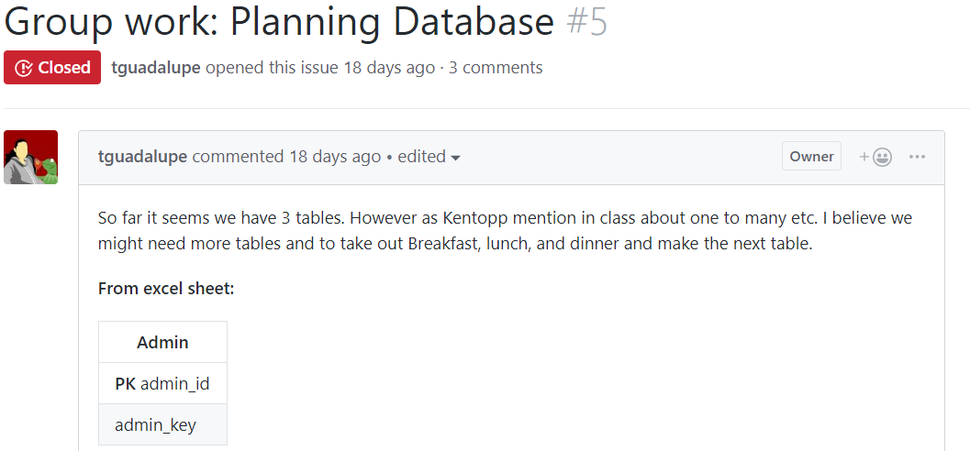
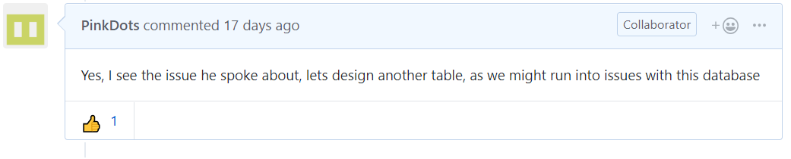
Database Tables Planning
This picture shows us planning the Database tables in github.
Link to Database Tables Planning: https://github.com/tguadalupe/UVI-Dining/issues/5
Notes:
Thalia and I planned the database tables. We had problems with the first one, so we then reworked it.

Slide 7
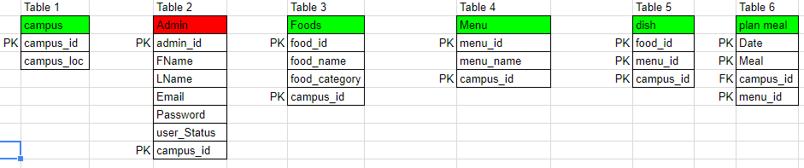
Final Database tables
Link to Database Tables Planning: https://github.com/tguadalupe/UVI-Dining/issues/5
This is our final database tables.
Notes:
This is our final database tables. Rhonda and I both worked on the tables and the issues we had were resolved.

Slide 8
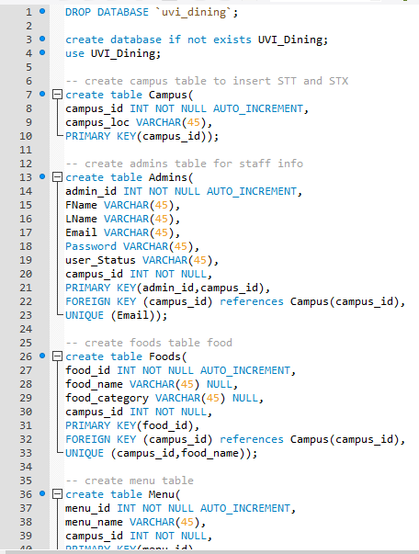
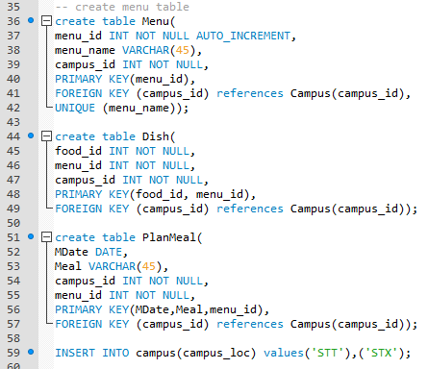
Thalia - MySql Script
Mysql Script:
The script contain the creation of the 6 tables: Campus, Admins, Foods, Menu, Dish, PlanMeal.
Notes:
Thalia:
After Rhonda and I planned out our database on Google Sheets I created our Mysql Script. Here you can see that my script can run properly with no errors and created all the tables.
Below “create table PlanMeal” you can see that I insert two campus value to the campus table.

Slide 9
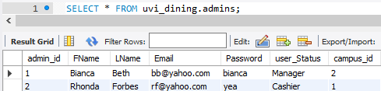
Thalia - Admins table
Figure 1 Populating admin tables
Figure 2 What’s inside the Admins tables
Here is the Admins tables where I populate the table with a inset command.
This will be use will be use to insert staff/display staff when they login.
Notes:
Thalia:
Scrolling down to the script you will see the image figure one that I inserted two admins account for the database. Figure 2 image show that the insert command worked.

Slide 10
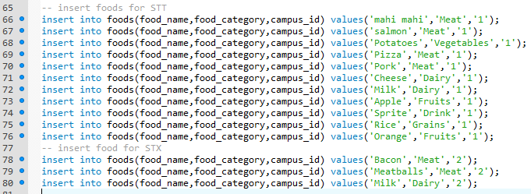
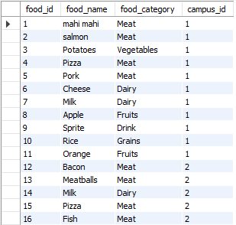
Thalia - Foods table
Here is the Foods table where I populate the table with a inset command.
This will be use to:
display foods to the user when.
Let user add foods
Figure 1 Populating Foods table
Figure 2 What’s inside the Foods tables
Notes:
Thalia:
Scroll down more and you will see more inserted command to the database. As you can see on Figure one I Populated the Foods table for both campus.
On Figure 2 it show that mysql command worked.

Slide 11
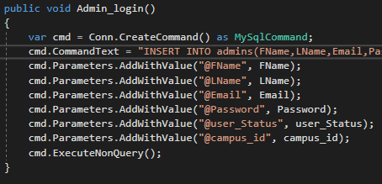
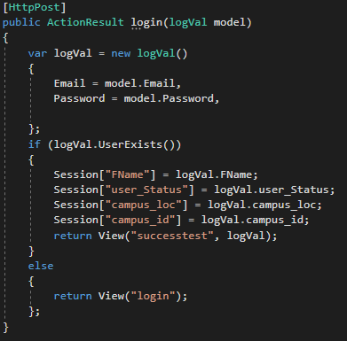
Thalia - Controller/Model: Login
Model:
Connection from the database.
Getting variables to be use for the controller.
Controller:
Call model class
Get Email & password
Create if statement
It check if the user is in the database or not.
Figure 1 Model Class: Login logic for database
Figure 2 Controller Class: Login logic to access names variable for controller
Notes:
Thalia:
Inside my model class I created a variable called “cmd” to get my connection string and use it to creaete mysql commands.
I use my sql query “INSERT INTO admins(FName,LName,Email,Password,user_Status,campus_id) values(@FName,@LName,@Email,@Password,@user_Status,@campus_id)” then send it to a variable in order to use it for the controller.
In my controller class I called the model class and get my value from the View and the model in order to compare if the user account is in the database.
I also have the Session so once the user login it can keep the user login and I can get all my sql queries to work for that user until the user logout. I also created a if statement to check if the user is in the database. If you the user is not in the database then it wont let the person login to the admin welcome page.

Slide 12
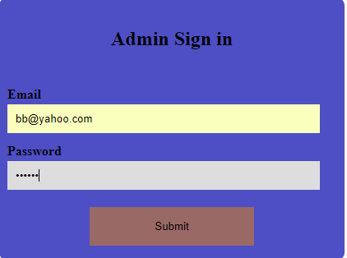
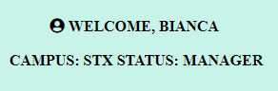
Thalia - Demonstration: Login
Figure 1 Login as the staff “Bianca”
Figure 2 Shows that the staff “Bianca” successfully login & the database information is display to the staff.
Notes:
Thalia:
Here I’m demonstrating the the user “Bianca” can login. If “Bianca” is in the database then it will let her in. As you can see “Bianca” was able to login and the database display her information.

Slide 13
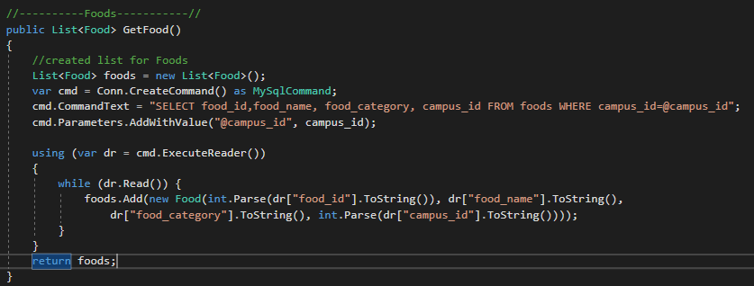
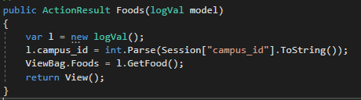
Thalia - Controller/Model:Display Foods
Model:
Connection from the database.
Getting variables to be use for the controller.
Use a while loop to display a list of foods
Controller:
Call model class
Get campus_id & Getfoods method
Figure 1 Model Class: Display foods logic for database
Figure 2 Controller Class: Display foods logic to access names variable for controller
Notes:
Thalia:
Inside my model class I created a variable called “cmd” to get my connection string and use it to create mysql commands.
I use my sql query “SELECT food_id,food_name, food_category, campus_id FROM foods WHERE campus_id=@campus_id” then send it to a variable in order to use it for the controller.
In my controller class I called the model class and get my value from the View and the model in order for the food to be display as a list..

Slide 14
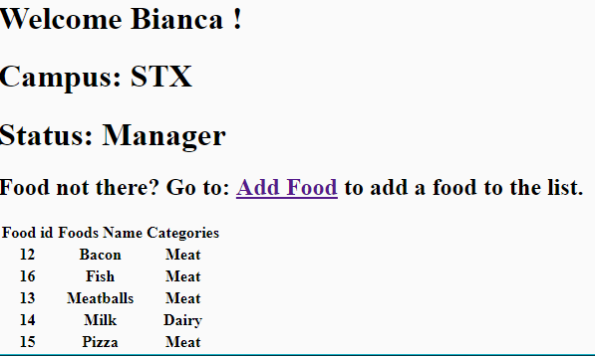
Thalia - Demonstration: Display Foods
NEW FEATURE!
Figure 1 Shows that the foods from St. Croix display to the staff “Bianca”
Notes:
Thalia:
Here I’m demonstrating that the user “Bianca” can see the list of foods and their ID and food categories for St. Croix Campus.

Slide 15
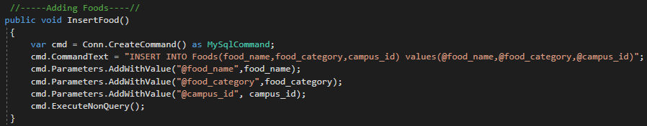
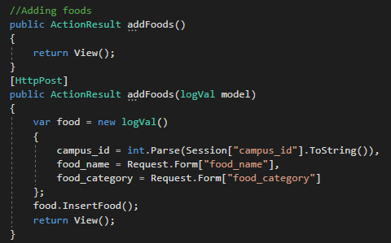
Thalia - Controller/Model:Add Foods
Model:
Connection from the database.
Getting variables to be use for the controller.
Controller:
Call model class
Get campus_id, food_name, & food_category.
Figure 1 Model Class: Add foods logic for database
Figure 2 Controller Class: Add foods logic to access names variable for controller
Notes:
Thalia:
Inside my model class I created a variable called “cmd” to get my connection string and use it to create mysql commands.
I use my sql query “INSERT INTO Foods(food_name,food_category,campus_id) values(@food_name,@food_category,@campus_id)” then send it to a variable in order to use it for the controller.
In my controller class I called the model class and get my value from the View and the model in order for the user to add foods to the list.

Slide 16
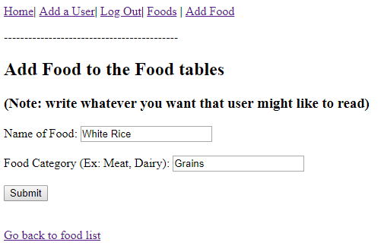
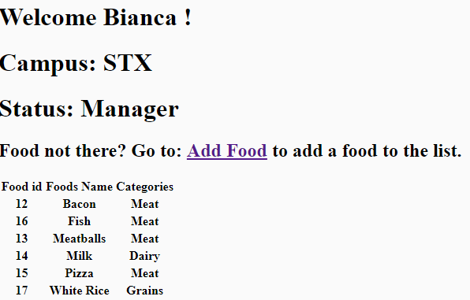
Thalia - Demonstration: Display Foods
NEW FEATURE!
NEW FEATURE!
Figure 1 Shows that the Staff can add foods to the list of Foods.
Figure 2 Shows that the Staff successfully added a food that they wanted in the Food table list.
Notes:
Thalia:
Here I’m demonstrating that the user “Bianca” can add foods to the list for St. Croix campus.

Slide 17
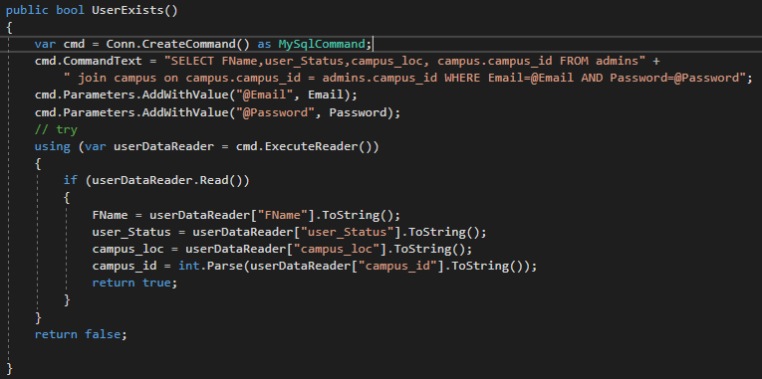
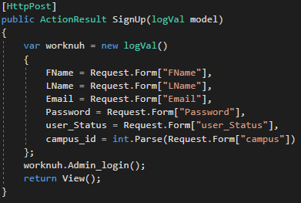
Thalia - Controller/Model: Add user
Model:
Connection from the database.
Getting variables to be use for the controller.
Create if statement to read in data.
Controller:
Call model class
Get FName, LName, Email, Password, user_Status, campus_id
Figure 1 Model Class: Add user logic for database.
Figure 2 Controller Class: Add user logic to access names variable for controller
Notes:
Thalia:
Inside my model class I created a variable called “cmd” to get my connection string and use it to create mysql commands.
I use my sql query “SELECT FName,user_Status,campus_loc, campus.campus_id FROM admins join campus on campus.campus_id = admins.campus_id WHERE Email=@Email AND Password=@Password” then send it to a variable in order to use it for the controller.
In my controller class I called the model class and get my value from the View and the model in order for the user to the database.

Slide 18
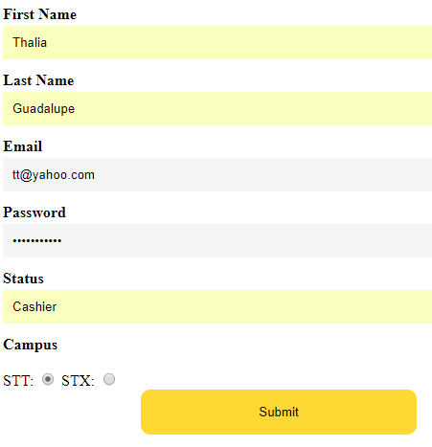
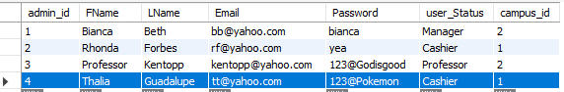
Thalia - Demonstration: Adding staff members
NEW FEATURE!
Figure 1 Shows that the Staff can add a staff.
Figure 2 Shows that the Staff successfully added a staff member to the database.
Notes:
Thalia:
Here I’m demonstrating that the user “Bianca” can add a user “Thalia” for St. Croix campus. As you can see the user “Bianca” was about to create an account for Thalia.

Slide 19
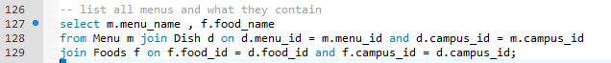
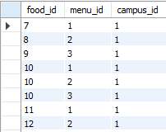
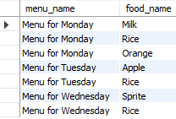
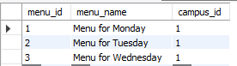
Thalia - Mysql: SQL Queries test
Figure 1 SQL queries that select and from menu and join the dish table to get the menu_name, food_name, food_id & campus_id
Figure 3 SQL queries result when query ran for Dish table
Figure 2 SQL queries result when query ran. Shows that the food name is associated to the name of the menu_name.
Figure 4 SQL queries result when query ran for Menu table
Purpose:
To test if our database can let a user select foods item and give it a name to create a meal combo.
Notes:
Thalia:
Here I created test queries for future part of the project. I was testing to see if our database can select foods and name it as a meal combo. This is important for when user can select the food they want and name it to whatever they want to be use later.

Slide 20
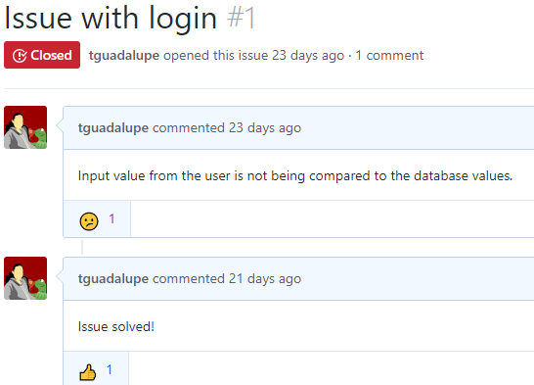
Thalia - GitHub: Post Issue: Login
Issue:
My user input value was not comparing if user is in the database.
Resolved:
If statement was not correct.
Comparing variable to itself instead of the user input
Link to Issue Form: https://github.com/tguadalupe/UVI-Dining/issues/1
Notes:
Thalia:
I posted a Issue that I had with login. My issue was that my input value was not comparing the user and anybody could login even if the user is not in the database.
I solved the issue by realizing that I was comparing the variable wrong.

Slide 21
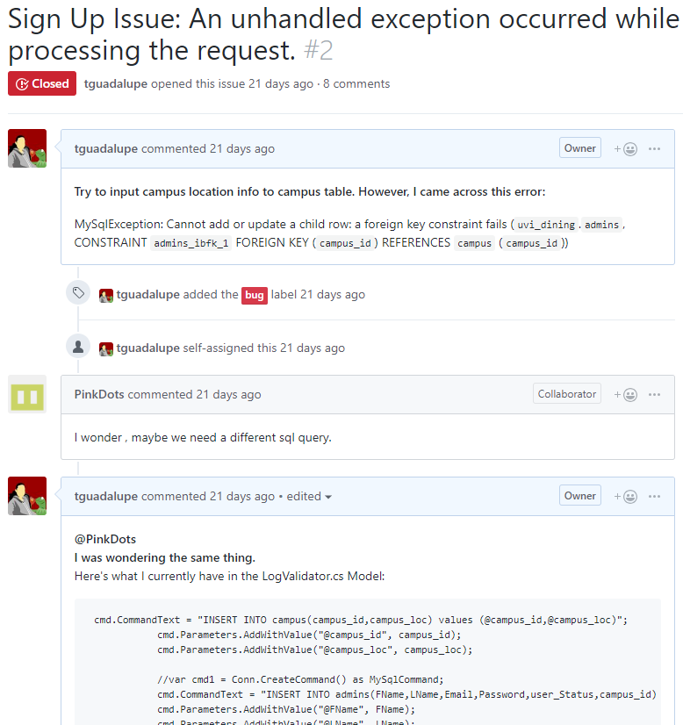
Thalia - GitHub: Post Issue: SignUp Issue
Issue:
Attempt to insert campus option for user to pick which campus their are from.
Resolved:
Campus table was missing insert values for STT.
It must have populated value for campus.
Link to Issue Form: https://github.com/tguadalupe/UVI-Dining/issues/2
Notes:
Thalia:
I posted a issue regarding my Sign Up.The issue was that the campus_id was crying about child and parents.
Rhonda try to debug it and give suggestion. We try to figure out together to see what was the issue. It turns out that we did not populated the value for campus. After we populated it the program worked again.

Slide 22
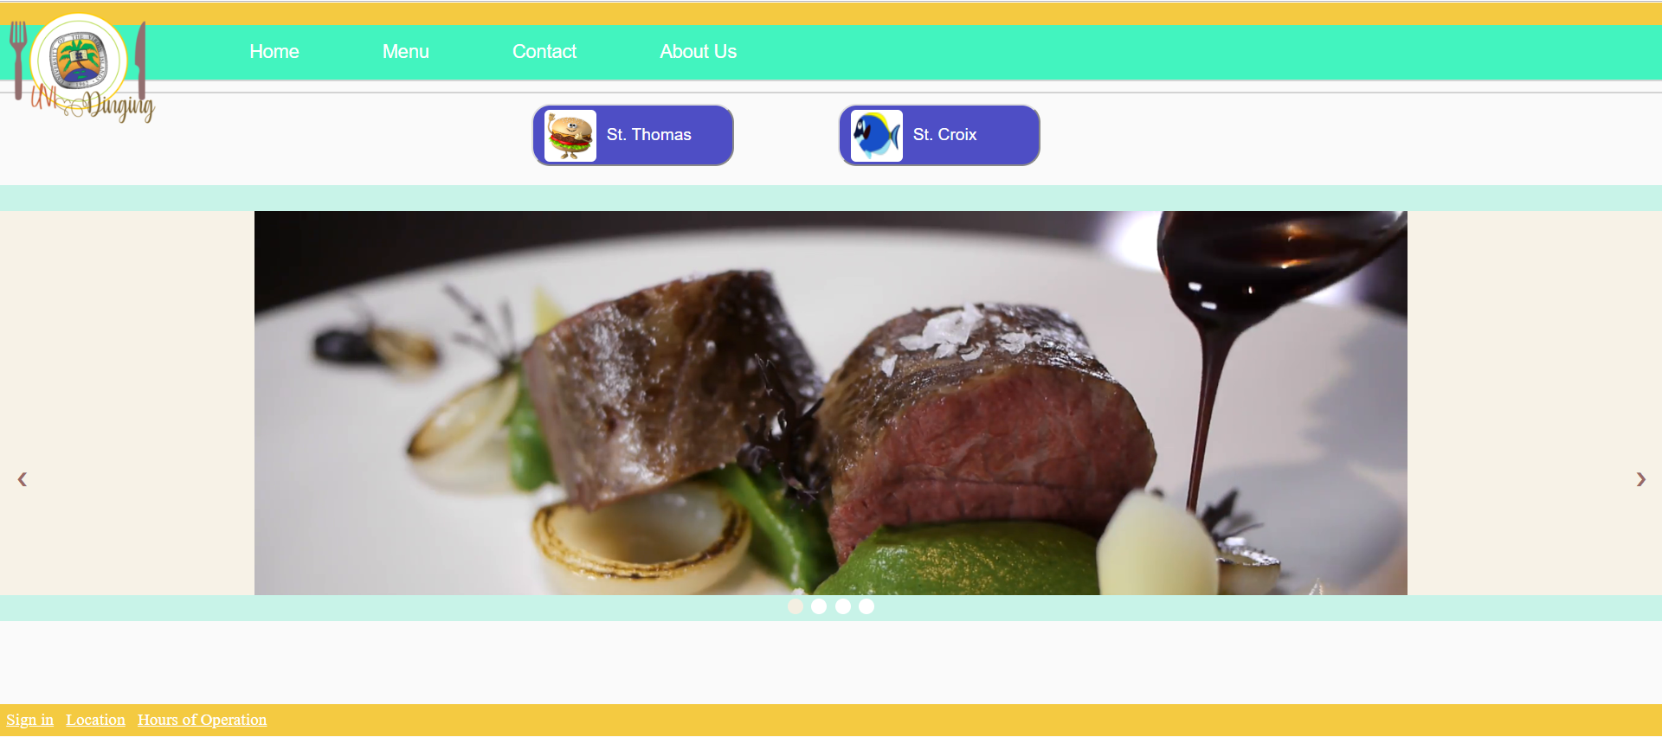
Rhonda - View Welcome Page
This is the welcome page.
This is the first page all users will see.
Notes:
Rhonda: The view is the part I worked on. This is the welcome page that all users will see when they visit the website. It consists of the UVI logo, designed by Thalia, and display pictures. It has a top navigation bar, which consists of Home, Menu, Contact and about us. It has a bottom navigation bar the consists of sign in, location and hours of operation. Both the top navigation bar and bottom links to other pages.

Slide 23
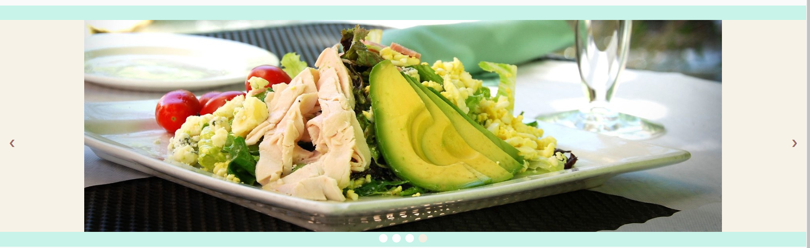
Rhonda - Welcome Page Slideshow
This is the welcome page slideshow.
Slideshow is auto and manual.
Notes:
Rhonda: This is the welcome page slideshow. It has an automatic and manual slide show that display pictures. Users can click on the arrows or dots to change the pictures. The arrows darkens when a user hovers over them and the dots change colors to indicate the picture it’s currently using.

Slide 24
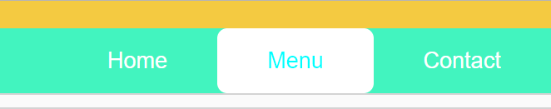
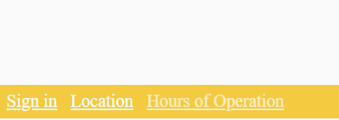
Rhonda - Welcome Page Navigation Bars
This is the welcome page features.
Top navigation and bottom navigation bars have
hover feature.
Notes:
Rhonda: In the top navigation bar, users can hover the mouse over links, and it’ll indicate that by forming a solid border around it and the text changing color. In the bottom navigation bar, when users hove the mouse over links, the links turn a different color.

Slide 25
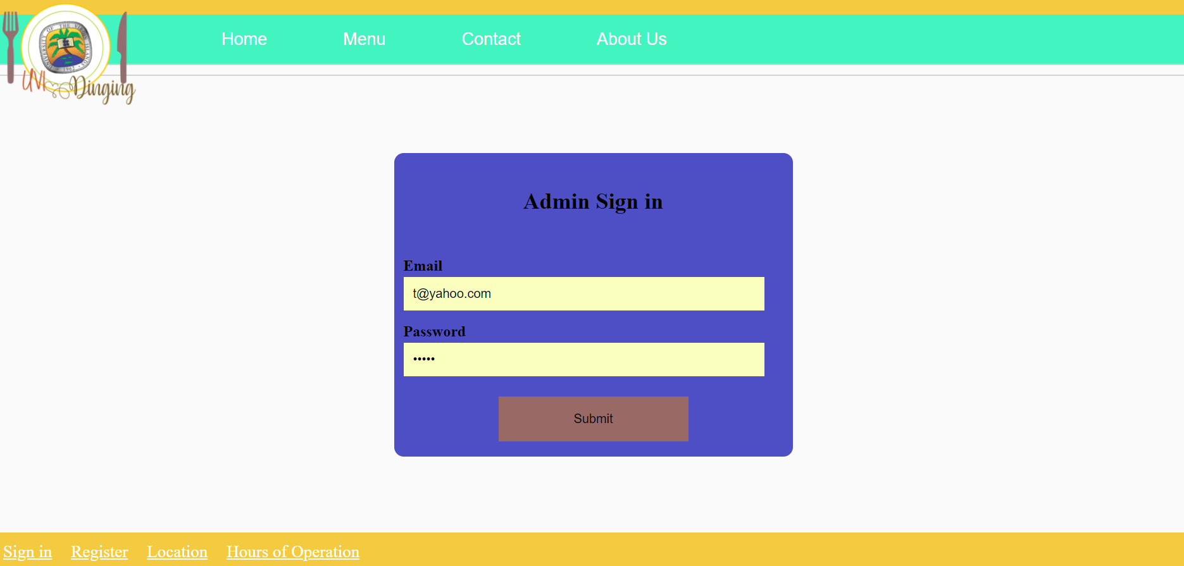
Rhonda - Sign in Page
This is the sign in page.
This is the page the staff will sign in to.
Notes:
Rhonda: This is the sign in page where the cafeteria workers will sign in to gain access to the admin page. The cafeteria workers can enter their email address and password information. The password the staff use is hidden for security purposes. It has a top navigation and bottom navigation bar.

Slide 26
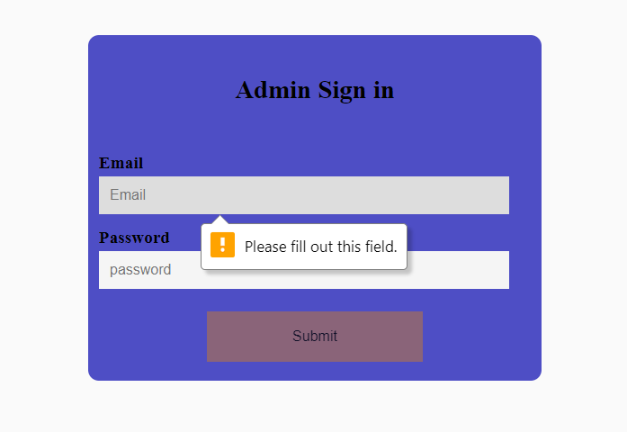
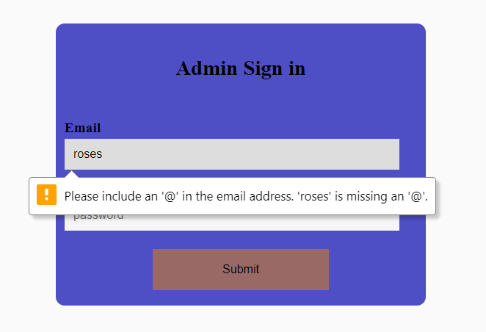
Rhonda - Sign in Page Form
This is the sign in page.
Users have to enter an email address and password.
Notes:
Rhonda: Other security measures that was implemented was the sign in form doesn’t allow the users to sign in with empty fields. It also doesn’t allow users to sign in without a properly formatted email address.

Slide 27
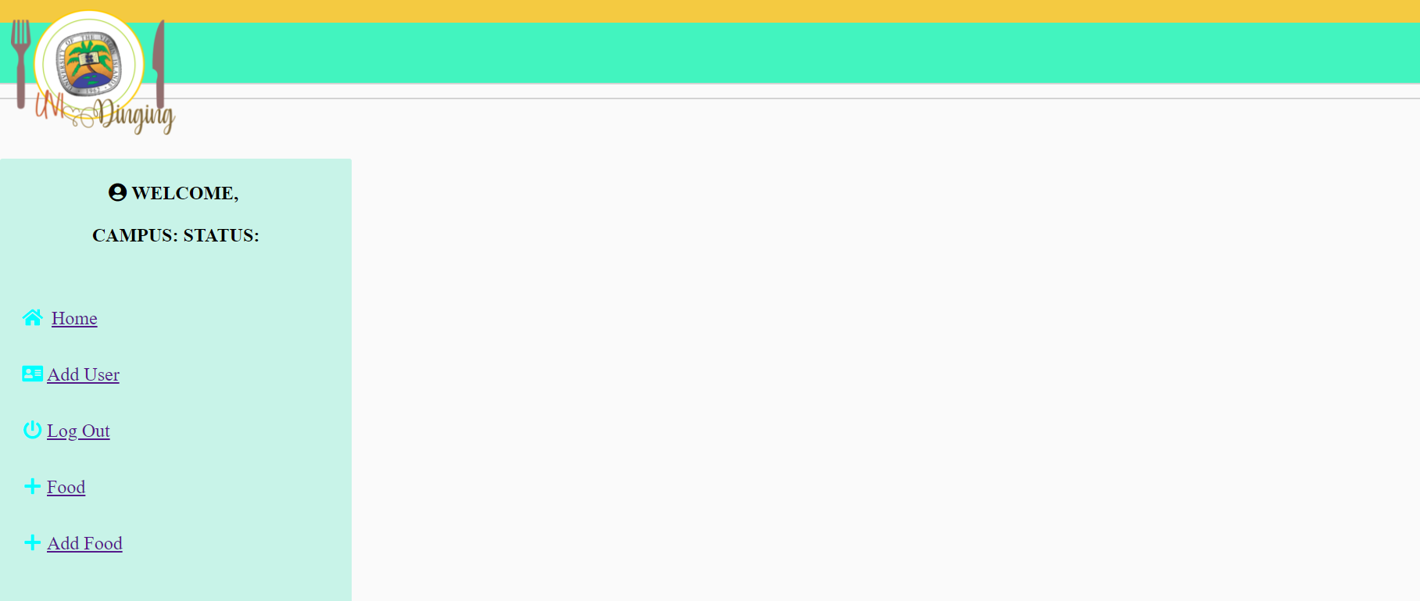
Rhonda - Admin Page
NEW FEATURE!
This is the admin page
Cafeteria workers will see this page after signing in.
Notes:
Rhonda: This is the admin page the cafeteria workers will get access to after they successfully sign in. It has a side navigation bar which consists of Home, Add User, Log Out, Food, and Add Food. All the links in the navigation bar goes to other pages.

Slide 28
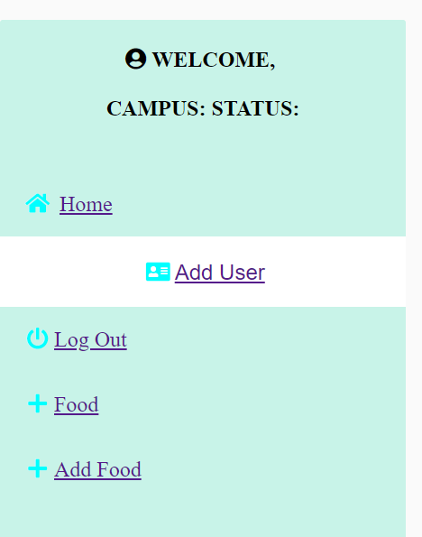
Rhonda - Admin Page Navigation Bar
NEW FEATURE!
Admin page navigation bar.
Has hover feature.
Notes:
Rhonda: This is the admin page side navigation bar. When users hover over a link, the background of the link changes and the link goes to the center of the page. There’s also icons next to the links.

Slide 29
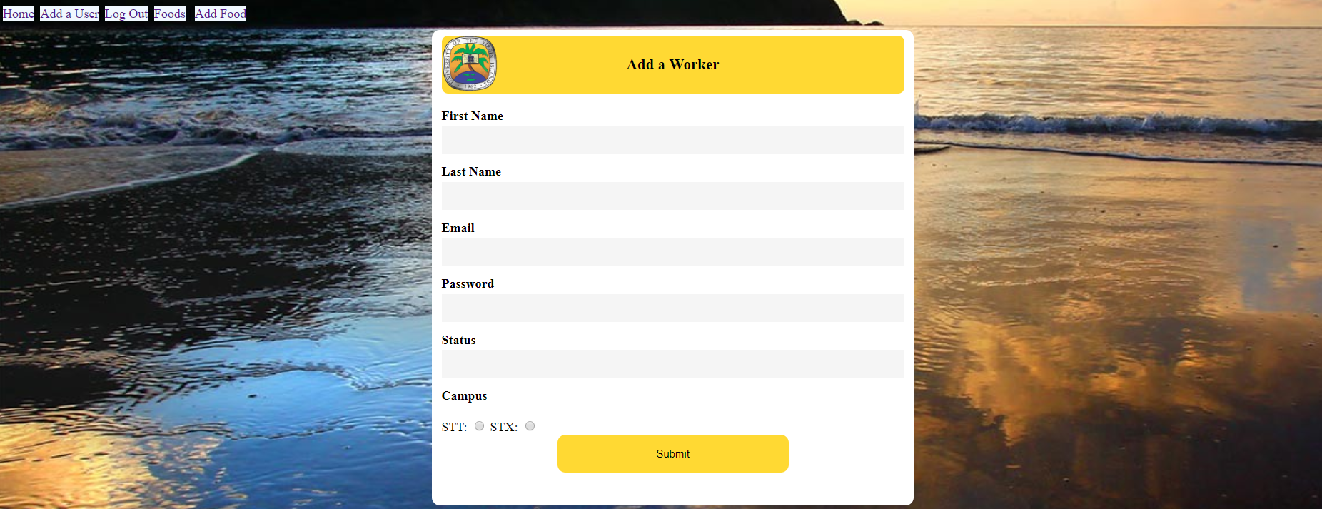
Rhonda - Add Worker Page
Add worker page.
Where cafeteria workers can add coworkers.
Notes:
Rhonda: This is the add worker pages where it allows cafeteria workers to other workers to the database. It has a top navigation bar which consists of Home, Add a User, Log Out, Foods, and Add Food. It has a sign in form that consists of First Name, Last Name, Email, password, Status and Campus. The navigation bar links to other pages.

Slide 30
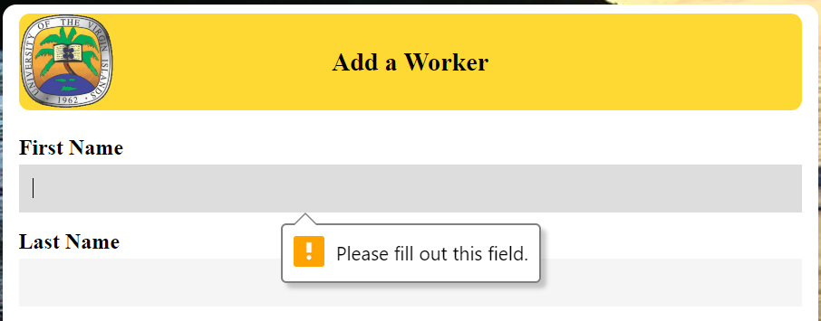
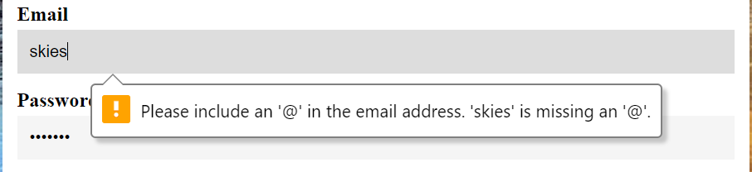
Rhonda - Add Worker Page Form
Add worker page.
Where cafeteria workers can add coworkers.
Notes:
Rhonda: This is the form for adding coworkers to the database. It doesn’t allow empty fields submissions. Email address must be properly formatted or else it won’t submit, and passwords are hidden.

Slide 31
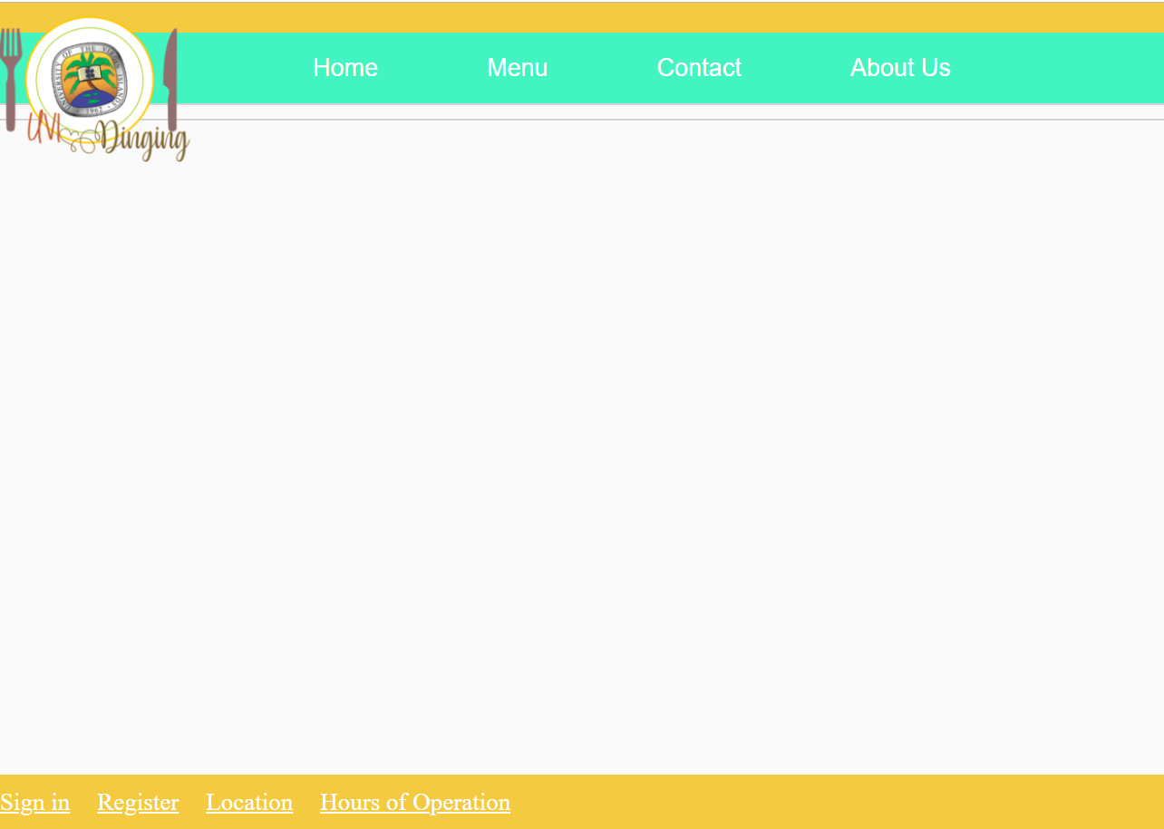
Rhonda - Other Pages Template
NEW FEATURE!
Template of other webpages.
Notes:
Rhonda: This is the template for other webpages in the top navigation bar and bottom navigation bar. Added more templates to links.

Slide 32
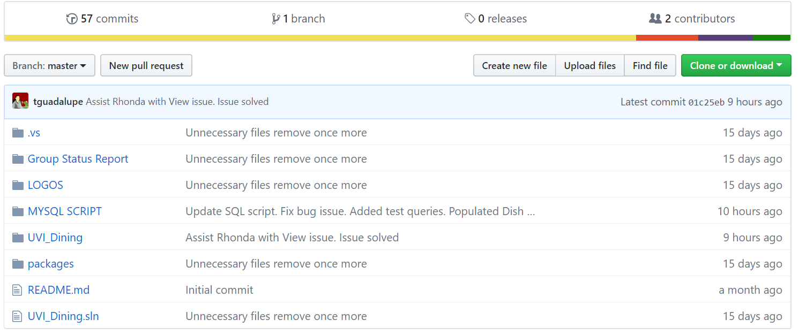
Rhonda - GitHub Repository
This is our github repository.
It has the problems we encountered and our project.
Notes:
Rhonda: This is our github repository. There is where we decided to host our project because of the features github offers. It allows communication between contributors and it made it easy for Thalia and I to share any issues we had with the website and also allow us to assist each other.

Slide 33
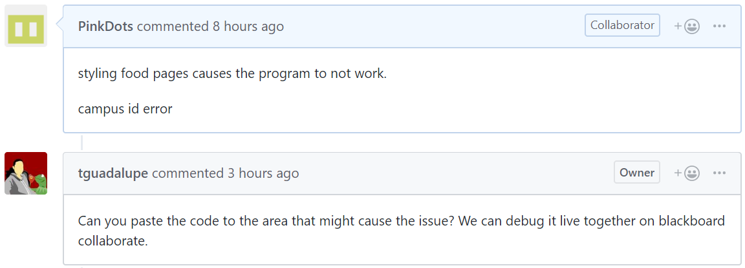
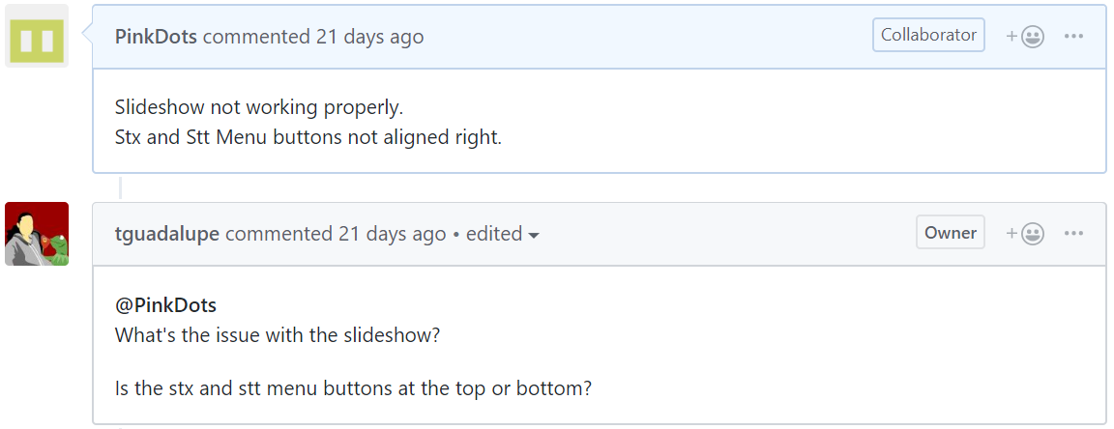
Rhonda - View Errors
Welcome page and food page view errors.
Here is the screenshot of me posting my errors on github.
Link to Issue Form: https://github.com/tguadalupe/UVI-Dining/issues/3
https://github.com/tguadalupe/UVI-Dining/issues/6
Notes:
Rhonda: When I started working on the welcome page, I had issues with getting the slideshow to work and the buttons to align properly. Thalia enquired about it and I was able to eventually fix the issue. I also had an issue with styling the food pages, the program would break. I posted the issue on github and Thalia and I both when in blackboard collaborate. Thalia spotted the issue and it was then resolved.

Slide 34
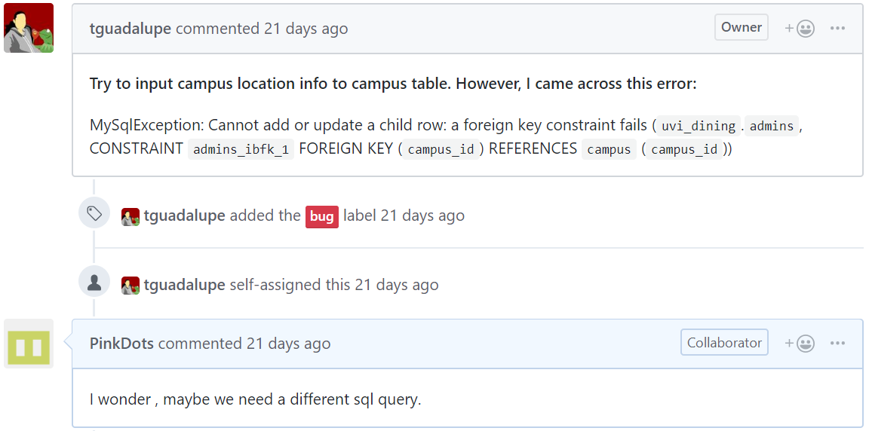
Rhonda - Other Github Errors
This is a picture of errors Thalia encountered
Link to Issue Form: https://github.com/tguadalupe/UVI-Dining/issues/2
Notes:
Rhonda: Thalia encountered some errors trying to insert the campus location into the campus table. Here, I gave her suggestions.

Slide 35
Group - Project download link
If you want to see our project or play with it you can download our project from github.
Thank you
Project link: https://github.com/tguadalupe/UVI-Dining
Notes:
This is the link to our project on github. You’ll be able to see how it works and make modifications to it.

